Slide 1
COMP 201 OPEN SOURCE & SYSTEM ADMINISTRATION
DANIEL OBUOBI
OPEN SOURCE SOFTWARE

Slide 2
what is open source software?
Open Source software is distributed with its source code. The Open Source Definition has three essential features:
It allows free re-distribution of the software without royalties or licensing fees to the author
It requires that source code be distributed with the software or otherwise made available for no more than the cost of distribution
It allows anyone to modify the software or derive other software from it, and to redistribute the modified software under the same terms.
Steven Weber, The Political Economy of Open Source Software, BRIE Working Paper 140,
http://brie.berkeley.edu/~briewww/pubs/pubs/wp/wp140.pdf

Slide 3
what is free/libre/open source software?
Users are allowed to run the software for any purpose.
Users are able to closely examine and study the software and are able to freely modify and improve it to fill their needs better.
Users are able to give copies of the software to other people to whom the software will be useful
Users are able to improve the software and freely distribute their improvements to the broader public so that they, as a whole, benefit.
FLOSS Is Not Just Good for Your Teeth

Slide 4
Other definitions of OSS
http://www.opensource.org/docs/osd
http://www.fsf.org

Slide 5
examples of open source software
Operating Systems
Linux
FreeBSD, OpenBSD, and NetBSD: The BSDs are all based on the Berkeley Systems Distribution of Unix, developed at the University of California, Berkeley. Another BSD based open source project is Darwin, which is the foundation of Apple's Mac OS X.

Slide 6
examples of open source software
Internet
Apache, which runs over 50% of the world's web servers.
BIND, the software that provides the DNS (domain name service) for the entire Internet.
sendmail, the most important and widely used email transport software on the Internet.
Mozilla, the open source redesign of the Netscape Browser
OpenSSL is the standard for secure communication (strong encryption) over the Internet.categories.

Slide 7
example of open source software
Programming Tools
Zope, and PHP, are popular engines behind the "live content" on the World Wide Web.
Languages:
Perl
Python
Ruby
Tcl/Tk
GNU compilers and tools
GCC
Make
Autoconf
Automake
etc.

Slide 8
open source software sites
Free Software Foundation www.fsf.org
Open Source Initiative www.opensource.org
Freshmeat.net
SourceForge.net
OSDir.com
developer.BerliOS.de
Bioinformatics.org
see also individual project sites; e.g., www.apache.org; www.cpan.org; etc.

Slide 9
some dates from the history of open source
1970s: UNIX operating system developed at Bell Labs and by a diverse group of contributors outside of Bell Labs; later AT&T enforces intellectual property rights and “closes” the code
1983: Richard Stallman founds the Free Software Foundation
1993: Linus Torvalds releases first version of Linux built
1997: Debian Free Software Guidelines released
1998: Netscape releases Navigator in source

Slide 10
conventional models of software development
waterfall
from requirements to code without a backward turn
historically used for large military and corporate software productions; originally used because computing time was expensive
spiral
iterative cycles of requirements, development, testing, redrafting of requirements, etc.
B. W. Boehm. “A spiral model of software development and enhancement”. IEEE Computer, 21(5):61--72, 1988

Slide 11
open source software development
bazaar
“Treating your users as co-developers is your least-hassle route to rapid code improvement and effective debugging.”
Linus’s Law: “Given enough eyeballs, all bugs are shallow.”
Eric Steven Raymond, The Cathedral and the Bazaar, http://www.catb.org/~esr/writings/cathedral-bazaar/cathedral-bazaar/

Slide 12
open source software development

Slide 13
open source business models
service
support
education
extensions

Slide 14
open source companies
IBM
uses and develops Apache and Linux; created Secure Mailer and created other software on AlphaWorks
Apple
released core layers of Mac OS X Server as an open source BSD operating system called Darwin; open sourced the QuickTime Streaming Server, the OpenPlay network gaming toolkit, etc.
HP
uses and releases products running Linux
Sun
uses Linux; supports some open source development efforts(Forte IDE for Java and the Mozilla web browser)

Slide 15
open source companies
Red Hat Software
Linux vendor
ActiveState
develops and sells professional tools for Perl, Python, and Tcl/tk developers.

Slide 16
open source licensing
see http://www.opensource.org/licenses/
apache software license
python license
ibm public license
apple public source license
etc.

Slide 17
GNU General Public License
see http://www.opensource.org/licenses/gpl-3.0.html

Slide 18
creative commons
non-software licenses: see larry lessig’s “creative commons” project (http://www.creativecommons.org/learn/licenses)

Slide 19
creative commons’ licenses explained
Attribution. You let others copy, distribute, display, and perform your copyrighted work — and derivative works based upon it — but only if they give you credit.
Example: Jane publishes her photograph with an Attribution license, because she wants the world to use her pictures provided they give her credit. Bob finds her photograph online and wants to display it on the front page of his website. Bob puts Jane's picture on his site, and clearly indicates Jane's authorship.
www.creativecommons.org/learn/licenses

Slide 20
creative commons’ licenses explained
Noncommercial. You let others copy, distribute, display, and perform your work — and derivative works based upon it — but for noncommercial purposes only.
Examples: Gus publishes his photograph with a Noncommercial license. Camille incorporates a piece of Gus's image into a collage poster. Camille is not allowed to sell her collage poster without Gus's permission.
www.creativecommons.org/learn/licenses

Slide 21
creative commons’ licenses explained
No Derivative Works. You let others copy, distribute, display, and perform only verbatim copies of your work, not derivative works based upon it.
Example: Sara licenses a recording of her song with a No Derivative Works license. Joe would like to cut Sara's track and mix it with his own to produce an entirely new song. Joe cannot do this without Jane's permission (unless his song amounts to fair use).
www.creativecommons.org/learn/licenses

Slide 22
creative commons’ licenses explained
Share Alike. You allow others to distribute derivative works only under a license identical to the license that governs your work.
www.creativecommons.org/learn/licenses

Slide 23
open source as art
2004 golden nica award from ars electronica to the creative commons project
1999 golden nica award from ars electronica to the linux operating system
See the ‘Takeovers & Makeovers’ conference, November 7 & 8, 2008 @ UC Berkeley
http://bcnm.berkeley.edu/takeovers/

Slide 24
art as open source
open_source_art_hack, 2002
steve dietz and jenny marketou
http://www.netartcommons.net/
florian cramer essay

Slide 25
is software a form of politics?
The code of cyberspace -- whether the Internet, or net within the Internet -- the code of cyberspace defines that space. It constitutes that space. And as with any constitution, it builds within itself a set of values, and possibilities, that governs life there ... I've been selling the idea that we should assure that our values get architected into this code. That if this code reflects values, then we should identify the values that come from our tradition -- privacy, free speech, anonymity, access -- and insist that this code embrace them if it is to embrace values at all. Or more specifically still: I've been arguing that we should look to the structure of our constitutional tradition, and extract from it the values that are constituted by it, and carry these values into the world of the Internet's governance -- whether the governance is through code, or the governance is through people.
“Open Code and Open Societies: Values of Internet Governance,” Larry Lessig (1999)

Slide 26
A Brief History
Popular graphical computers
Apple Macintosh
Microsoft Windows
Linux
Alternative for people whose computing needs require something different

Slide 27
The UNIX Operating System
UNIX
Operating system
Originally created at AT&T Bell Labs in early 1970s
Designed to control networked computers that were shared by many users
Features and low cost of Linux effectively driving UNIX out of market

Slide 28
The Free Software Foundation and the GNU Project
Free software foundation (FSF)
Software itself should not be restricted in distribution by standard commercial license agreement
GNU project
Completely free version of UNIX
Written from scratch

Slide 29
The Free Software Foundation and the GNU Project (continued)
Software license
Legal definition of who can use software and how it can be used
GNU general public license (GPL)
Very different from standard commercial software license
Author agrees to give away source code
Anyone is licensed to redistribute it in any form

Slide 30
The Free Software Foundation and the GNU Project (continued)
GNU GPL
Any modifications to the source code must be licensed under the GPL
Sometimes called copyleft
OpenSource
Refers to software licensed under GPL
Public domain
No one has copyright to software
Not same as GPL

Slide 31
Linux Arrives
Linus Torvalds
Decided to create UNIX-like operating system kernel for IBM-compatible PC
Solicited help via Internet
Released Linux kernel under GPL
Linux development method
Person identifies need and begins writing program
Developer announces project on Internet

Slide 32
Linux Arrives (continued)
Linux development method (continued)
Others respond and work on different parts of project
Person leading project releases software
People download source code and try program; send back information about problems
Developers fix bugs
Forking
Creating new project based on existing source code

Slide 33
Motivating Free Software Developers
Why would so many people devote so much effort to something without expecting any reward?
Fills developer’s specific technical need
Respect of like-minded professionals
Sense of contribution and community
Valuable boost to developer’s resume

Slide 34
The Strengths Of Linux
Stability
Security
Speed
Cost
Multiprocessing and other high-end features
Applications

Slide 35
NOW READ THE REST YOURSELF

Slide 36
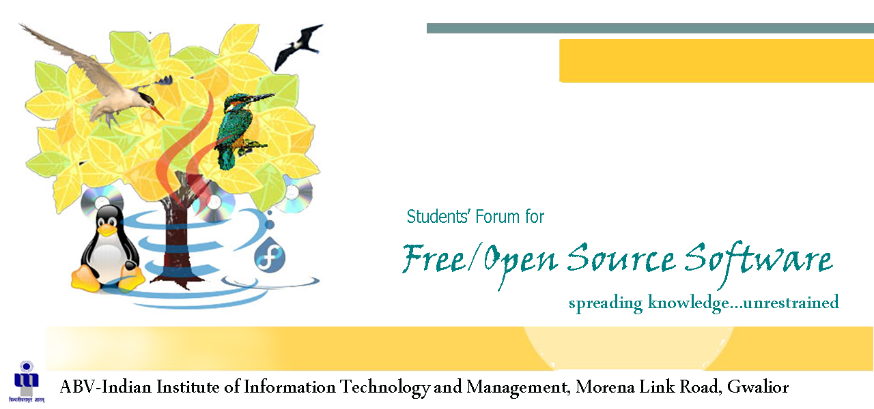
Presented By:
Avijit Gupta
V. SaiSantosh

Slide 37

About Open Source Software
Open Source Software can be defined as computer software for which the human readable source code is made available under a copyright license that meets the Open Source Definition. This permits users to use, change, and improve the software, and to redistribute it in modified or unmodified form. It is very often developed in a public, collaborative manner.

Slide 38
About Open Source Software
Open source software generally allows anyone to make a new version of the software, port it to new operating systems and processor architectures, share it with others or market it. The aim of open source is to let the product be more understandable, modifiable, reliable or simply accessible, while it is still marketable.

Slide 39
Philosophy
Users should be treated as co-developers
Early releases
Frequent integration
Several versions
High modularization
Dynamic decision making structure

Slide 40
Licensing Of Open Source Software
Open source licenses define the privileges and restrictions a licensor must follow in order to use, modify or redistribute the open source software. Open source software includes software with source code in the public domain and software distributed under an open source license.
Examples of open source licenses include Apache License, BSD license, GNU General Public License etc.
The proliferation of open source licenses is one of the few negative aspects of the open source movement because it is often difficult to understand the legal implications of the differences between licenses.

Slide 41
Open Source Products
Many FOSS products like LINUX, APACHE, and FIREFOX etc. have begun to gain mainstream acceptance and many companies are also releasing their own software under open source. As the internet is transforming much of the software business into a service, very large parts of the software that enables this to happen are expected to become free and open.

Slide 42
About Linux… The Open Source Operating System
Linux is the name usually given to any Unix-like computer operating system that uses the Linux kernel. Linux is one of the most prominent examples of free software and open source development: typically all underlying source code can be freely modified, used, and redistributed by anyone.
.

Slide 43
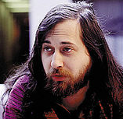

About Linux… The Open Source Operating System
The name "Linux" comes from the Linux kernel, originally written in 1991 by Linus Torvalds. The system's utilities and libraries usually come from the GNU operating system, announced in 1983 by Richard Stallman. The GNU contribution is the basis for the alternative name GNU/Linux
Richard Stallman, founder of the GNU project.
Linus Torvalds, creator of the Linux kernel

Slide 44
About Linux… The Open Source Operating System
The primary difference between Linux and many other popular contemporary operating systems is that the Linux kernel and other components are free and open source software. Linux is not the only such operating system, although it is the best-known and most widely used.
As an operating system underdog competing with mainstream operating systems, Linux cannot rely on a monopoly advantage; in order for Linux to be convenient for users, Linux aims for interoperability with other operating systems and established computing standards.

Slide 45
Advantages of Open Source Software
Software experts and researchers on open source software have identified several advantages
The main advantage for business is that open source is a good way for business to achieve greater penetration of the market.
it offers the potential for a more flexible technology and quicker innovation.
It is flexible because modular systems allow programmers to build custom interfaces, or add new abilities to it and it is innovative since open source programs are the product of collaboration among a large number of different programmers

Slide 46
Disadvantages of Open Source Software
Software experts and researchers on open source software have identified some disadvantages:
It is sometimes said that the open source development process may not be well defined and the stages in the development process, such as system testing and documentation may be ignored.
Not all OSS initiatives have been successful, for example, SourceXchange and Eazel. Software experts and researchers who are not convinced by open source’s ability to produce quality systems identify the unclear process, the late defect discovery and the lack of any empirical evidence as the most important problems

Slide 47
Conclusion
As the internet is transforming much of the software business into a service, very large parts of the software that enables this to happen are expected to become free and open. However, there are many hurdles to be crossed before this potential becomes a reality, such as lack of awareness, absence of standards and inter operability criterion, lack of the required skill, training, absence of appropriate business models, insufficient user confidence, and its very newness itself.

Slide 48
Thank You!

